Slide 2
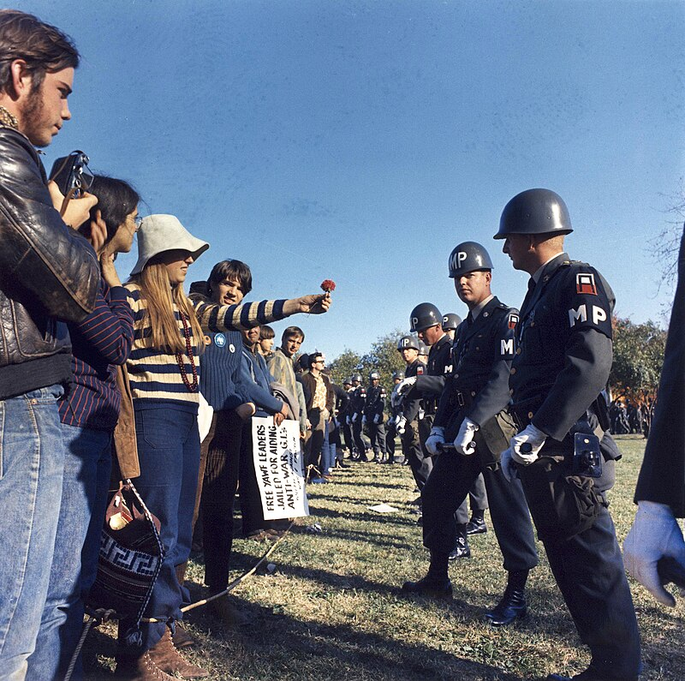
Flower Power
Origin Berkley California 1965
Poet Al Ginsburg
Anti war activist : Abbie Hoffman
Counter demonstration vs
Military parades
Abbi Hoffman: activist
"Plans are being made to mine the East River with daffodils. Dandelion chains are being wrapped around induction centers.... The cry of 'Flower Power' echoes through the land. We shall not wilt."

Slide 3
A Brief history of Narcotics in the USA
1800’s
No national legislation
Some states regulate labelling 1870.s, restriction on opium dens
“Opium addiction” rises 500% 1870;s—1890’s ..300,000 addicts 5/1,000 of population
Early 1900’s….”Progressive Era”…beginning or regulation
“Pure Food and Drug Act” 1906…accurate labelling….NOT prohibition
Opium Act of 1909.banned importation of opium for smoking
Harrison Narcotics Act 1914..prosecutes doctors administering opium/ state bans Cannabis
Move to prohibition
1924 Anti Heroin Ban..banned domestic production and distribution of heroin
1931 National “Marijuana Tax Act” .$1fine….”causes instant insanity, criminality, and death”
1938 LSD Switzerland (Lysergic Acid Diethylamide)..Dr Albert Hoffman
..used for psychotic illnesses
1950’s Boggs Act and Daniel Act increase penalties for marijuana…”causes migration to heroine”

Slide 4
Sixties cultural Transition
Triggers
Anti War / Civil Rights demonstrations question authority
Rising population of young people questioning government advice
Rising globalisation… increased availability of drugs Mexico, Jamaica, Asia –Vietnam war
Popularisation of psychedelic music…spread
Increased use of LSD
Promoted by Psychiatrist research/ Use by CIA interrogation 1950’s
Mass production in Berkley California by Owsley Stanley (“king of acid)…5m doses 1965-1967
Promoted by influential advocates
No legal restrictions till 1970
Triggers for cultural” revolution created
…needed right time / place/ promoters…..to expand…rapidly

Slide 5
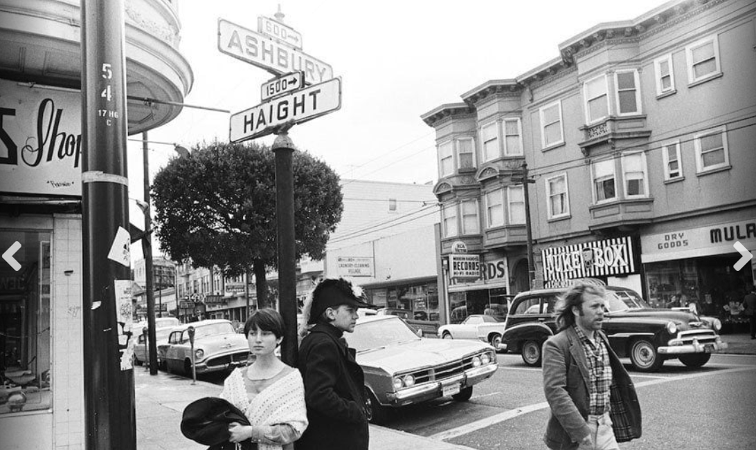
The Place: Haight Ashbury District San Francisco

Slide 6
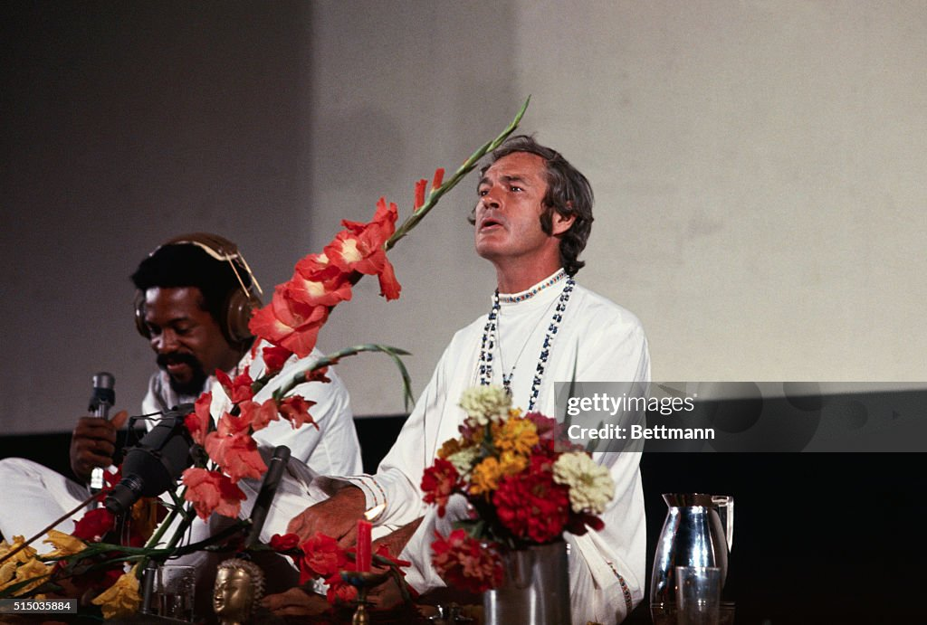
Lead Promotor: Timothy Leary (1920-1996)
Jesuit educated son of
Dentist. Expelled from
WestPoint….army psych WW2”
PHD Criminal Psychology
…”discovers” psilocybin”
…advocates use/ supplies students….fired
“Adopted” by Mellon Family
….tv personality…influential
Psychedelic celebrity…faked
Research allegations prisoners
Advocates supervised LSD use
.”Tune on…Tune In…Drop Out”
5 times married, arrested 36
Times…escape to Afghanistan
“Most dangerous man in USA”
…Richard Nixon

Slide 7
Haight Ashbury Early 1960’s
About Haight Ashbury
District of San Francisco: Centre for “beatniks” 1950s….global connected…then “hipster” ---”hippies”
Plentiful housing….rooms for rent..rates depressed by threat of freeway
Perfect weather….no winters/ summers
Rise of Psychedelic culture
Owsley Stanley lab set up 1965…supply of LSD
Jay Thelins Psychedelic shop set up 1965…..to distribute/ sell
“Diggers” anarchist is social movement …”Free Stores” movement
Media Interest…more stores opened/
“Hippy ideals”
Expand consciousness…use of psychedelics
Anti materialist/ collective ownership
Abandon routine…free love
100,000 young people converge on Haight Ashbury

Slide 8
The summer of love 1967
Human Be-in Festival …San Francisco January 1957
Timothy Leary “Drop Out/ Turn on/ Tune in speech
San Francisco January 1967
`San Francisco Oracle “A new concept of celebration beneath the human underground must emerge, become conscious, and be shared, so a revolution can be formed with a renaissance of compassion, awareness, and love, and the revelation of unity for all mankind.
Summer vacation 1967
100,000 youth converge San Francisco
Free love, drugs, spiritual awakening, anti war protests
Free love festivals spread across USA…..UK (Woburn Abbey( ,,,,and world

Slide 9
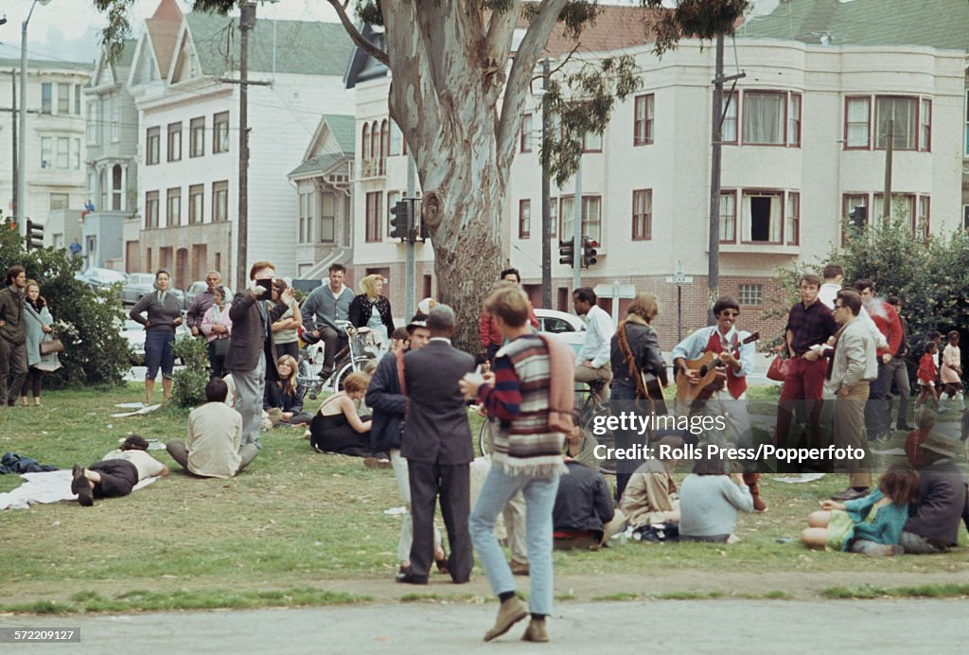
Haight Ashbury San Francisco 1967

Slide 10
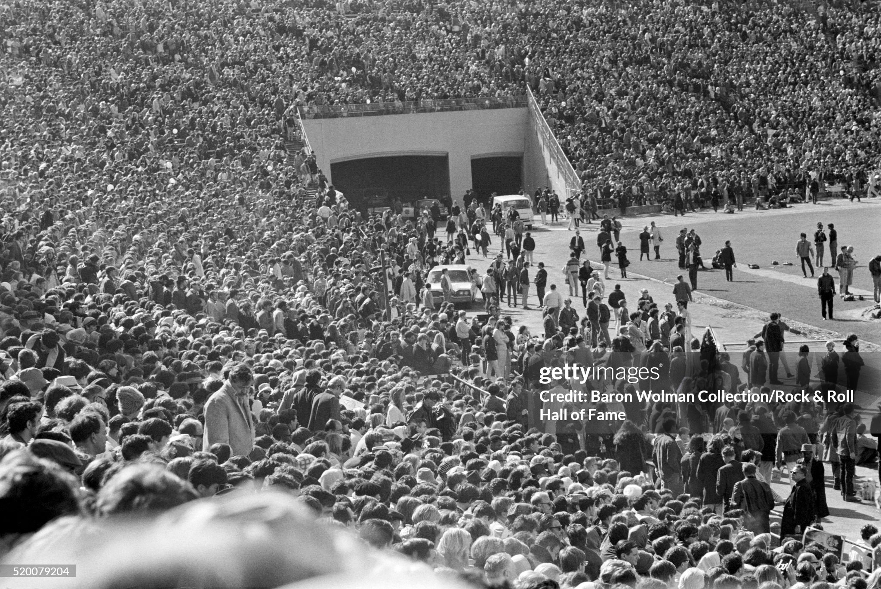
“Peace March” San Francisco June 1967

Slide 11
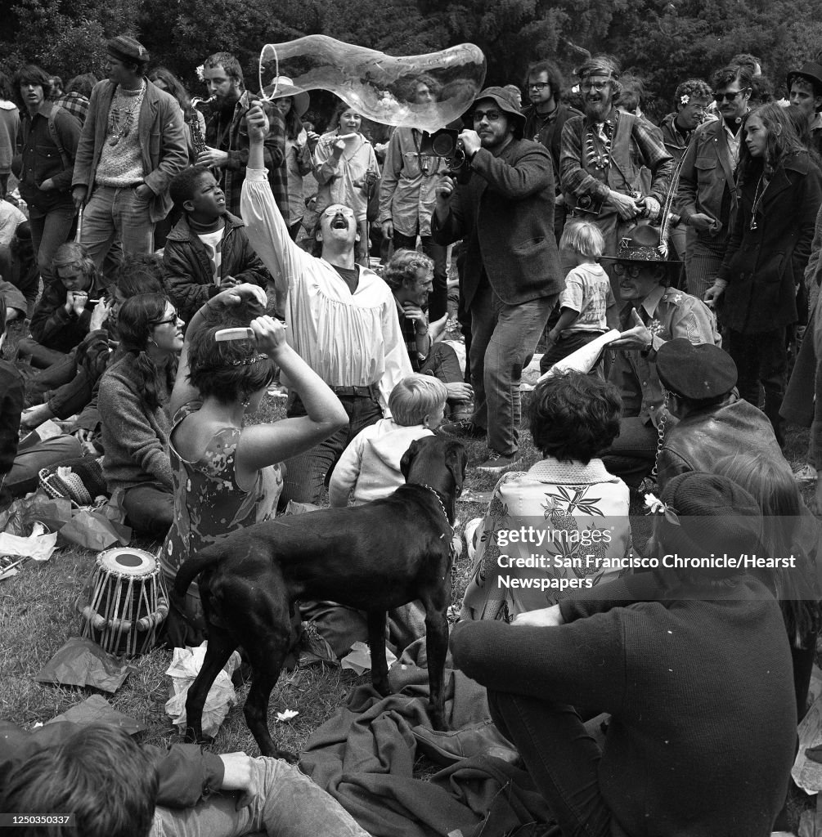
Golden Gate Park July 1967

Slide 12
Haight Ashbury ….a year later
Rising levels of malnutrition/Increased venereal disease
300% increase in rapes…”so common police give up trying to count
Homicide rates in San Francisco triple from 5.8 per 100k 1965 to 18 per 100k 1977
Enter organised crime as LSD outlawed…problem for the 1970’s
Reduced opportunities to “Drop Out” as economy declines in 1970’s
District becomes Tourist Destination
…many ex hippies “panhandlers” …filth, trash,

Slide 13
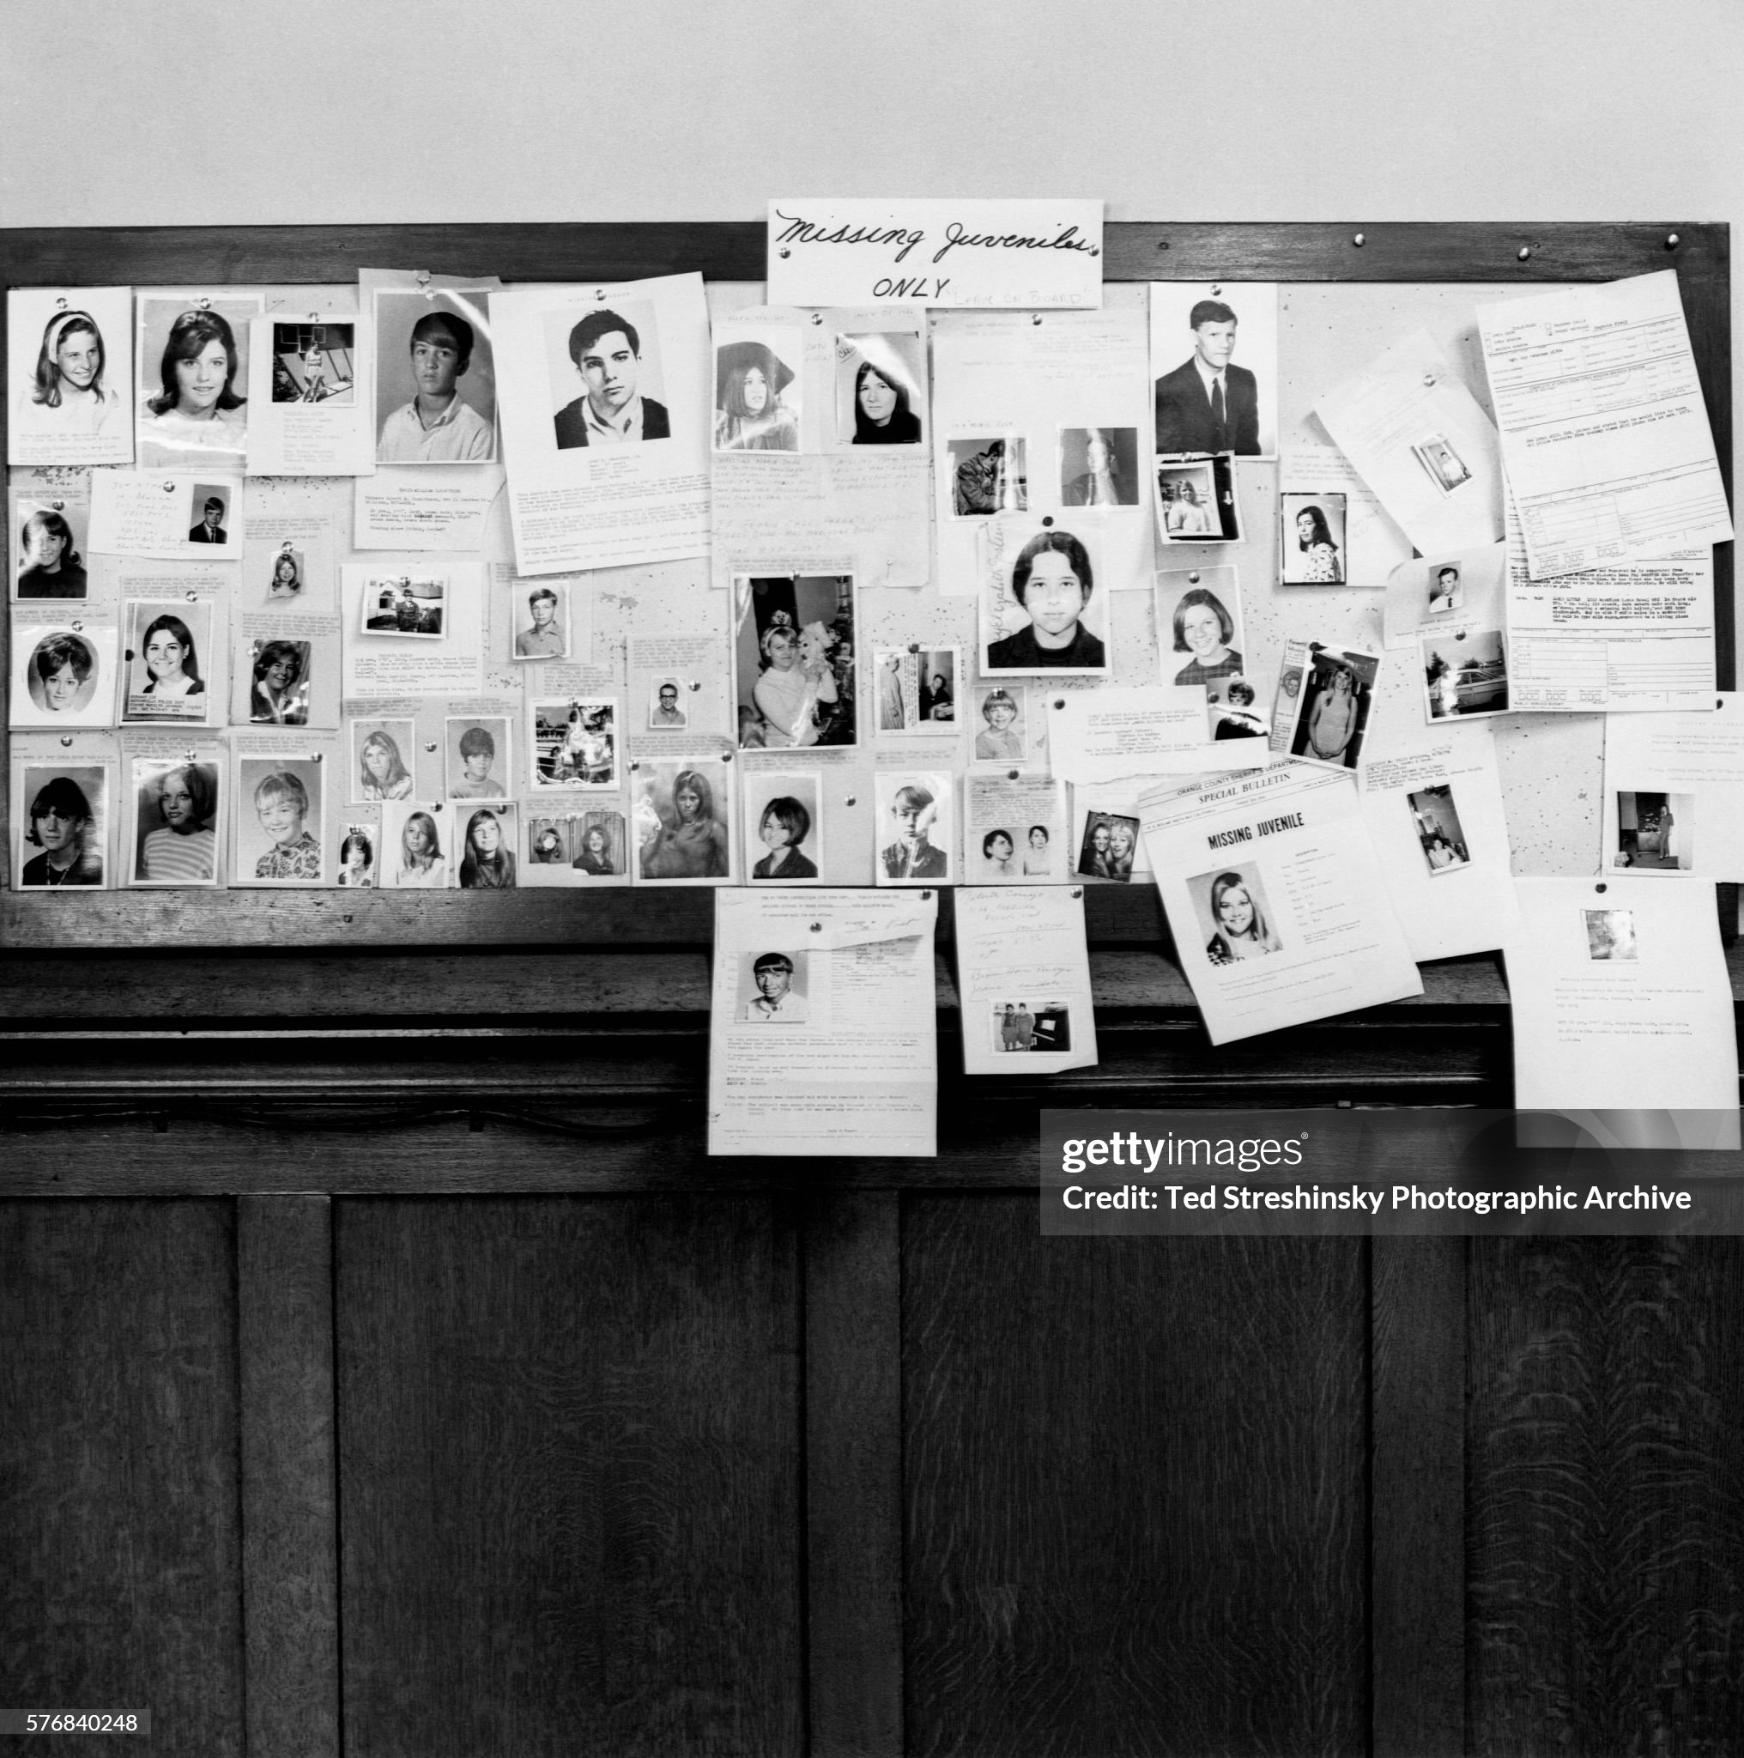
Aftermath…the missing children every child story, a family, bewildered and desperate parents

Slide 14
Future of “Flower Power” and Protest Movement
Expands across US and Europe to early 1970’s
Woodstock festival….1969---500,000 attend
Mass anti war protests continue till US involvement ends 1972
Contraction
“Cost of freedom” increases as economic conditions deteriorate in 1970’s
Image change (Manson Killings, Altamont Free Concert disaster 1969
Overdose deaths lead performers (Joplin, Hendrix, Morrisson,
Manson Killings in 1969 Los Angeles
Legacy
Increase in self expression/ reduction in conformity
“War on Drugs”….Controlled Substance Act 1970
Dramatic rise in criminality and violence across US

Slide 15
“Black Power”
Some political progress
Growing dissatisfaction with pace of change
City Riots…”Long Hot Summer” of 1967
Martin Luther King assassination 1968
Vietnam…over representation of black draftees/ causalities
Rise of Radical Black Movements…big on publicity, short on deeds
Nation of Islam rise due to Malcom X….separation/ Muslim/ violence
Black Panther (1965)..Marxist Leninist….revolutionary…self empowerment
Rise of Black Middle Class…steady progress, incremental improvements
 | 1960 | 1970
Senators (100) | 0 | 1
US Representatives (435) | 1 | 14
State Governors (50) | 0 | 0

Slide 16
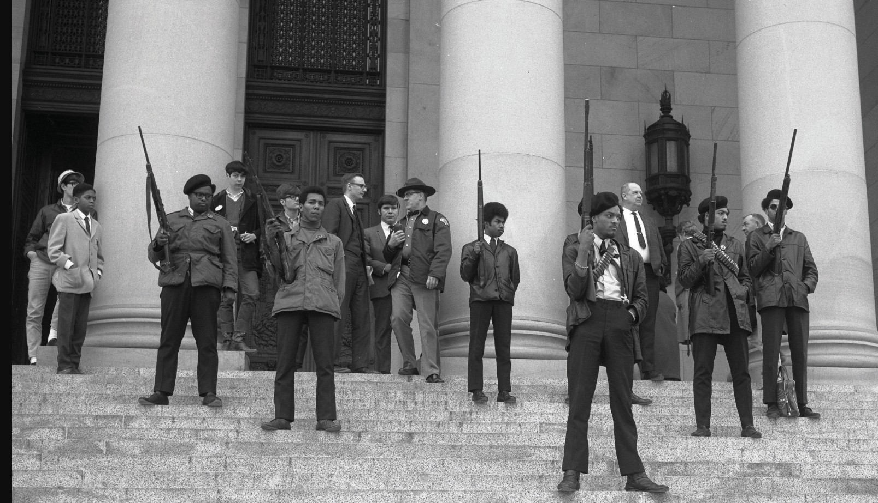
Black Panthers …protesting gun law restrictions Washington State 1969

Slide 17
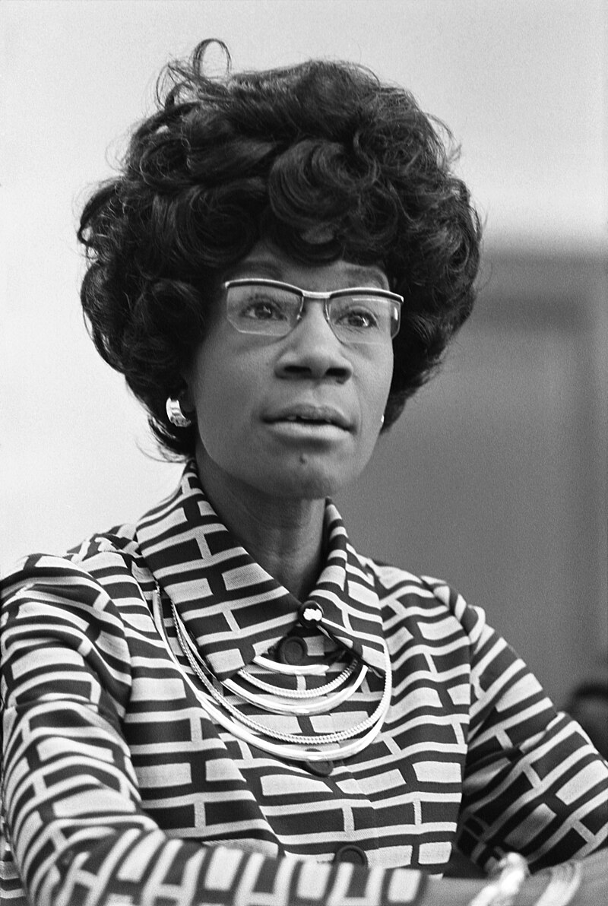
Shirley Chisolm (1924-2005)
Parents from Barbados…garment
District…sent to Barbados as child
…returns to US as 10 yr old
Shirley 1972
"Granny gave me strength, dignity,
and love. I learned from an early
age that I was somebody.
I didn't need the black revolution to
teach me that."[
Married…volunteers for politics
…State Assembly 1960-68
..practical, non ideological
..”unbought/ unsold”
First black woman in Congress 1969
….agricultural committee. Food stamps
…focus education, self help
Presidential candidate 1972…represent
District to 1983

Slide 18
Women in 1960’s USA: ….back seat to Civil Rights/ Anti War
 | 1960 | 1970
Senators | 1 | 1
US Representatives | 19 | 11
State Governors | 0 | 0
No political progress
New freedoms & Recognition for women’s rights
.Contraception approved as safe and legal 1960
“Feminine Mystique by Betty Friedan published 1963
Women not fulfilled solely by “domestic goddess” 1950’s role model
Systemic sexism repress the ability of women to achieve full citizenship
Civil Rights Act 1964….makes illegal sexual discrimination for job and pay
1967…National Organisation of Women formed…campaign vs legal constraints
1969…Gloria Steinman article “After Black Power, Women’s Liberation”

Slide 19
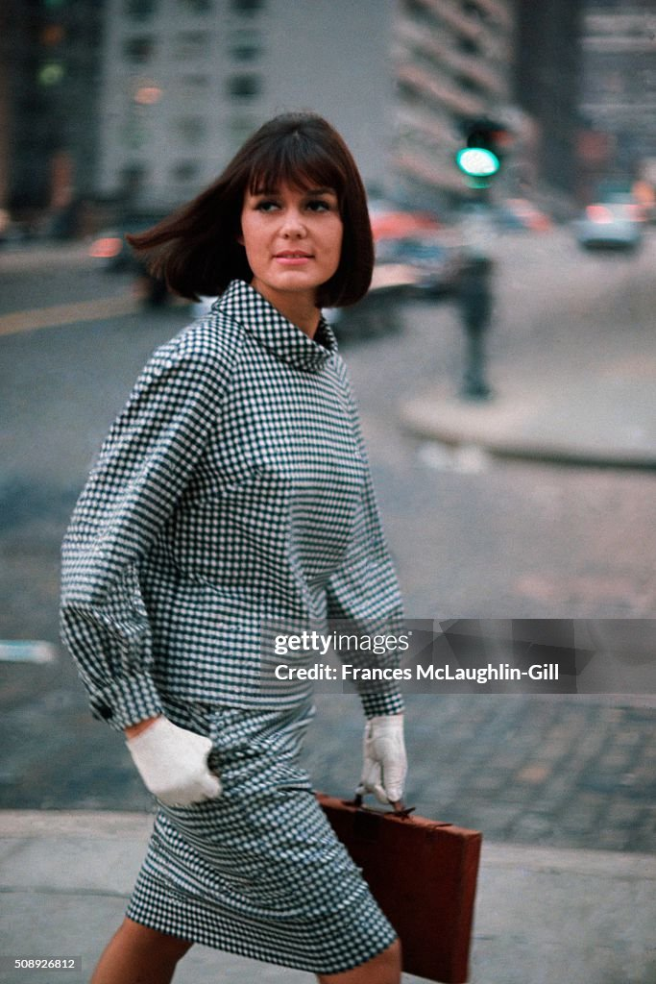
Gloria Steinman (1931…..)
Brought up in Trailer, Jewish father
Mother Presbyterian. Mother ill
Gloria 1963
Excellent student….scholarship to
Smith College (private women)
Writer…works for charity in India (CIA
Front)…abortion in London…to US
Freelance writer. Under cover “Playboy Bunny”…exposes conditions Cosmopolitan mag/ TV personality
Advocate for “feminist causes” …reproduction rights
Sex and race …have been the primary ways of
organizing human beings into superior and inferior
groups …we are talking about a society in which there will be no roles other than those chosen or those earned. We are really talking about humanism

Slide 20
Counter..counter Cultures

Slide 21
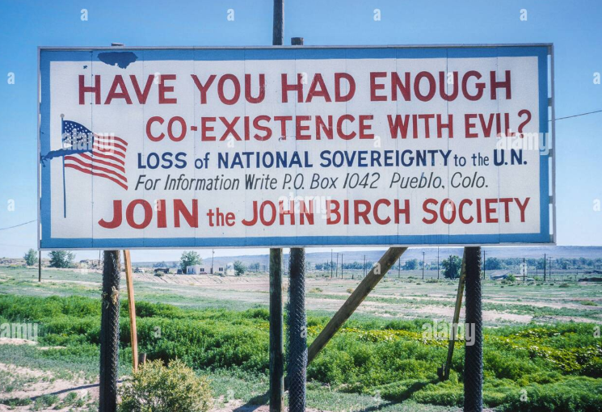
John Birch Society
Extreme Right Wing Group
..founded 1958 by Jack Welch
(candy magnate & Baptist)
..named after J Birch. Killed by Chinese
communists
Beliefs
…anti United Nations…”One World Order”
…anti Civil Rights…state decision
…anti Federal Reserve
…pro States Rights, guns, white supremacy
Authoritarian organisation
100,000 members 1960’s70s
…..father of “militia movements

Slide 22
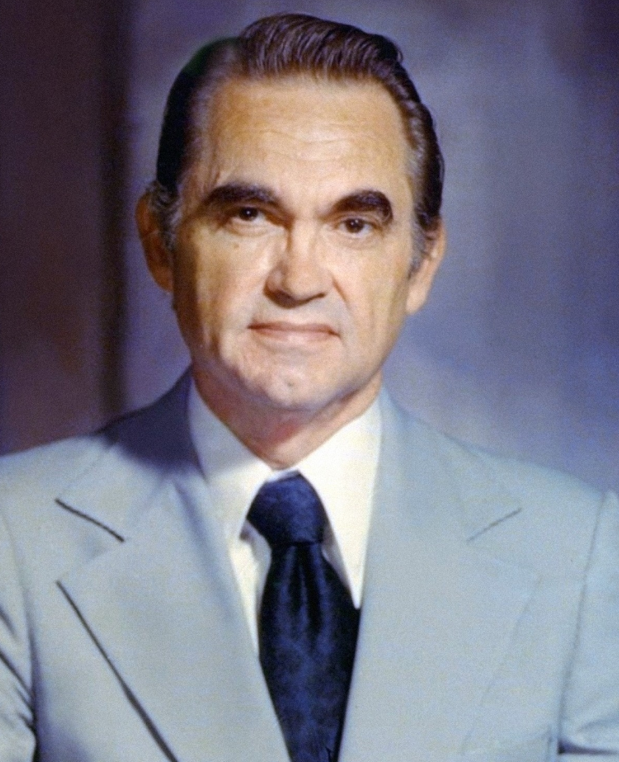
George Wallace 1919-1998
Governor of Alabama 1963-1987
Committed segregationist
…opposes KKK
…opportunist politician
“You know, I tried to talk about
good roads and good schools
and all these things that have
been part of my career, and
nobody listened. And then I
began talking about niggers,
and they stomped the floor."[
Goal: avoid “outniggered”
Creates white supremacist
3rd Party to resist Civil Rights
Relents after assassination 1972…apologises, “born again

Slide 23
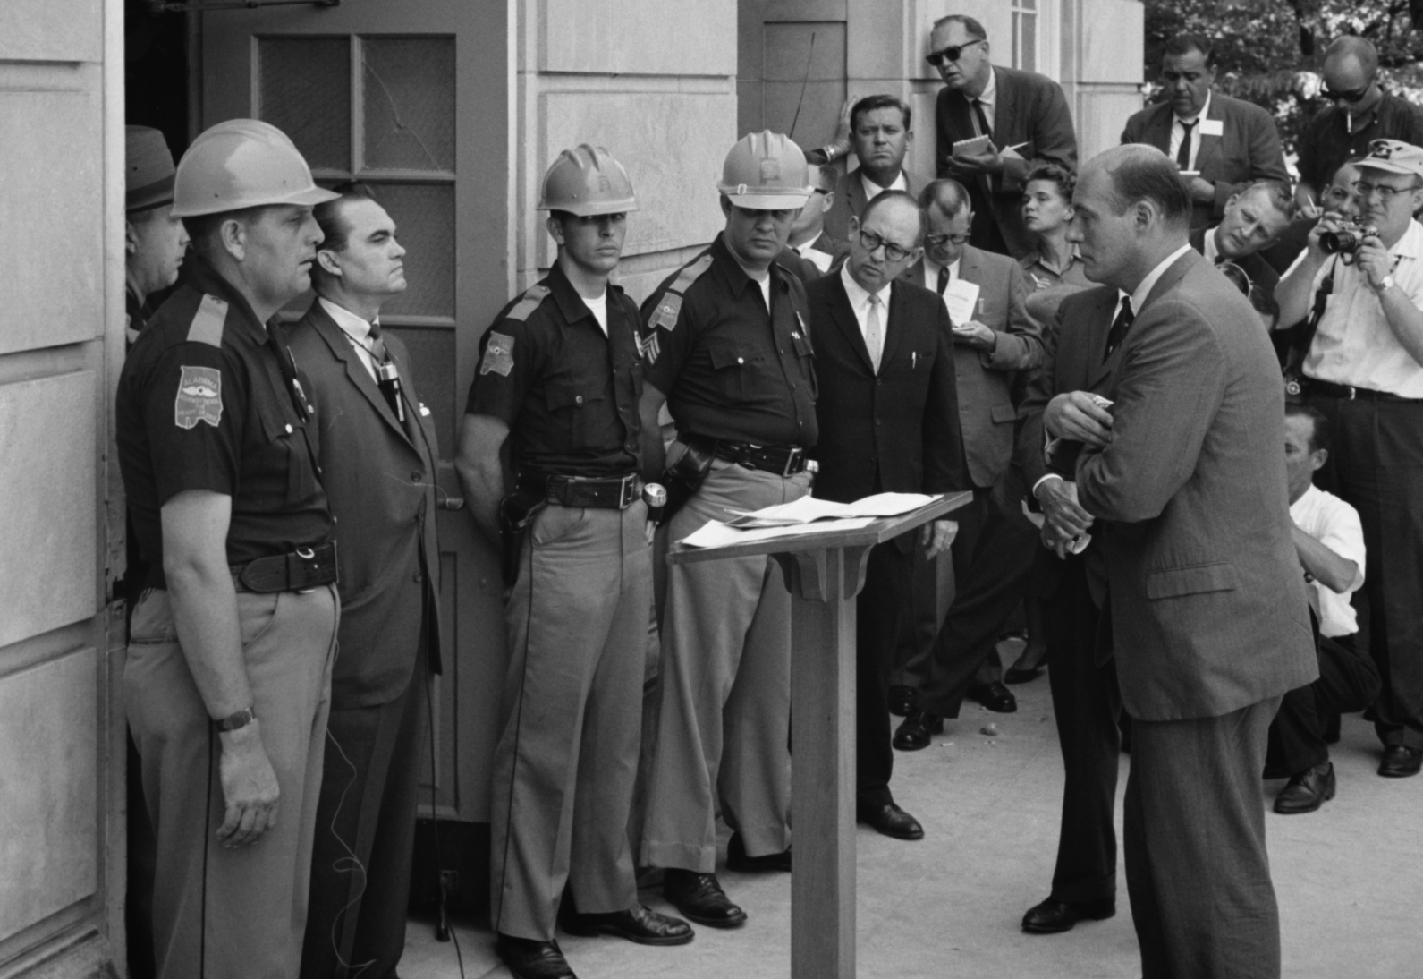
Wallace…..preventing black students entering university

Slide 24
Silent Majority
Majority of Americans late 1960’s wanted
Gradual introduction of civil rights…or not at all
End Vietnam war without admitting defeat
Oppose drug use/ promiscuity, LGBT
Law and Order
“Silent constituency”
White middle class secure jobs
Blue collar whites threatened by automation
Evangelical Christians
Mid West and South

Slide 25
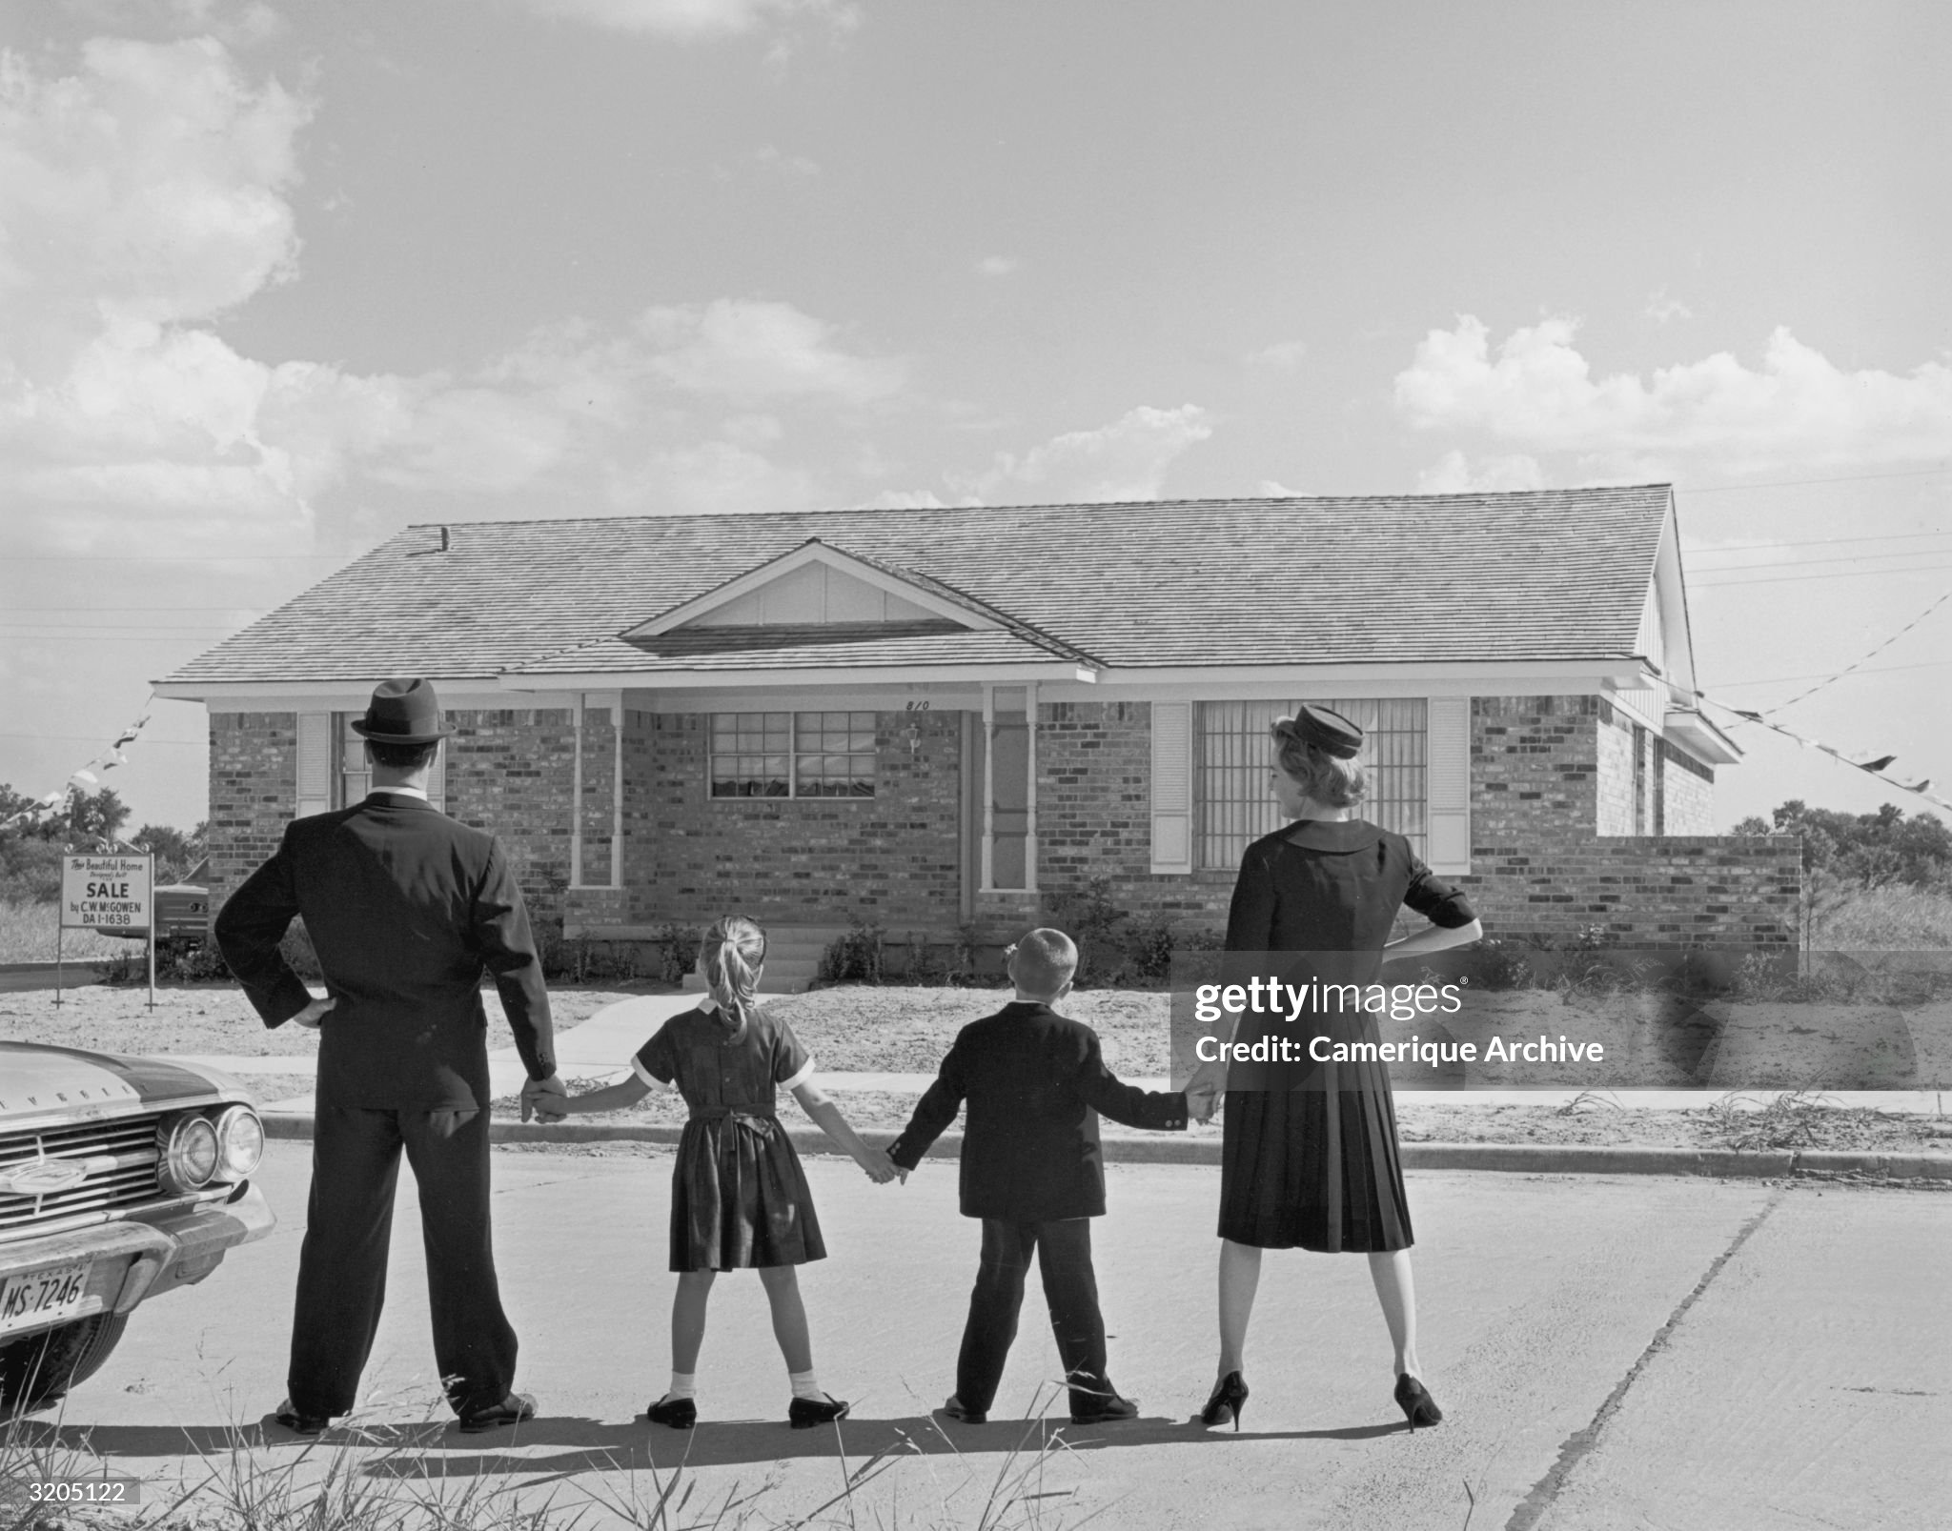
The American Dream……and hope of the “silent majority”

Slide 26
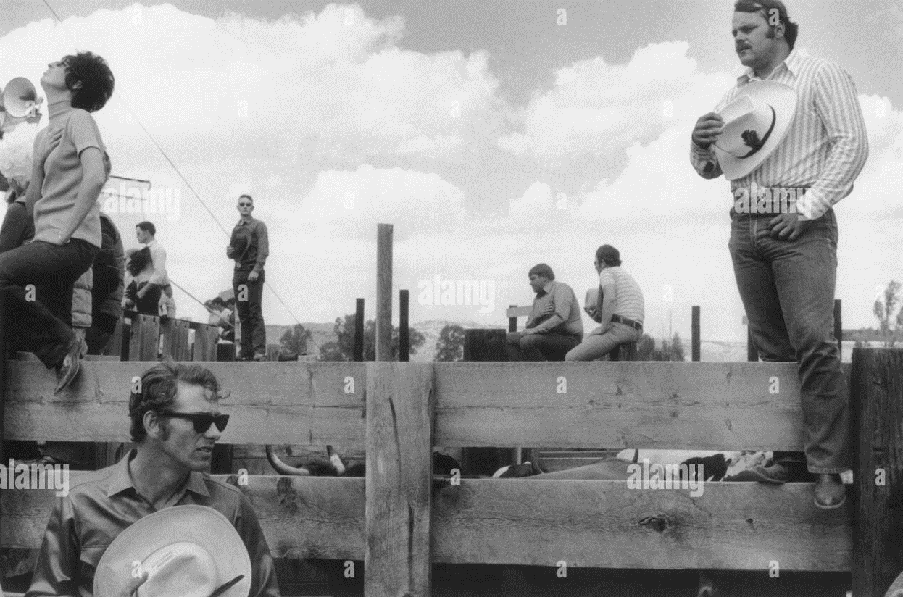
Radicals/ progressives the majority American Rodeo 1970

Slide 27
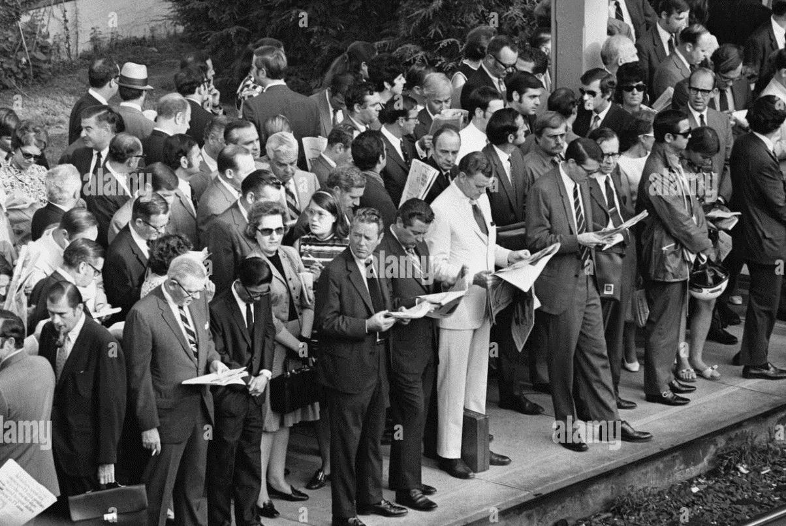
Silent Majority….not “flower power” ….waiting for train 1970 Philadelphia

Slide 28
“Pro War” Protests

Slide 29
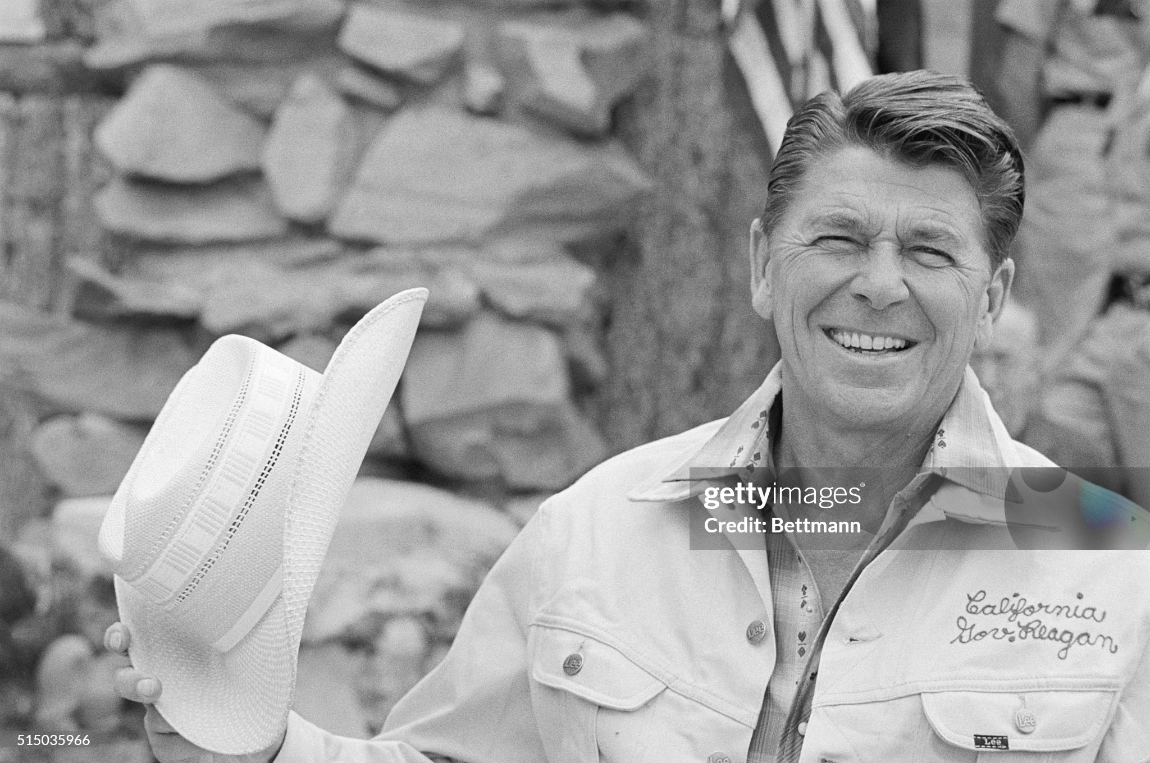
The rising Conservative "stars” Ronald Reagan Governor California

Slide 30
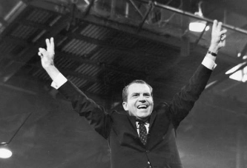
Richard Nixon Vice President 1952-1960 loser of 1960 election, loser of California Governor race 1952…rebranded as “everyman”

Slide 31
The Future “Progressives” (Great Society, Civil Rights, Big Government, Anti War, non conformity VS Conservatives: (Small government, States Rights, Peace with honour, “family values”
Next Talk 40 September 1st…Return of the Republicans

